Slide 1

Pawstacle Dash

Slide 2
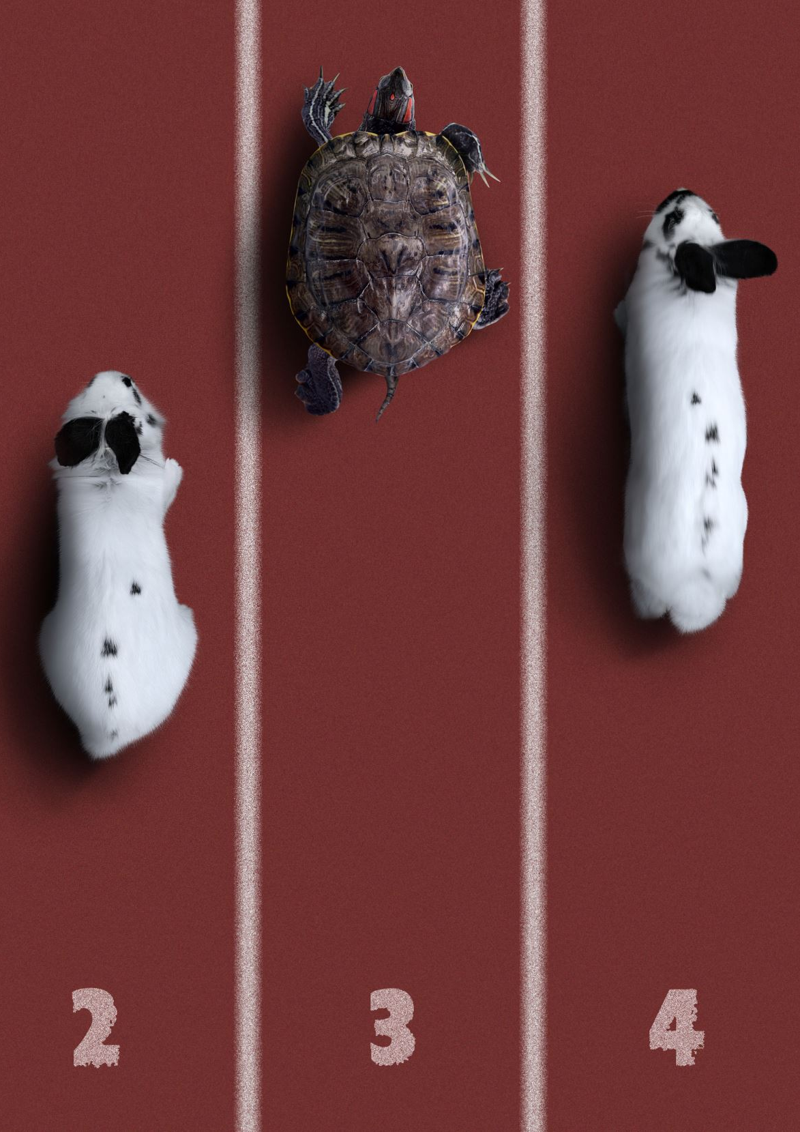
Game Concept
"Pawstacle Dash" is a charming obstacle avoidance game where players guide a lost dog safely home
Built with C++ and SFML, showcasing game development fundamentals,
Combines skill-based navigation with collection mechanics and progression

Slide 3
Game Objective & Story
The Journey Home
After wandering too far from home, our canine hero must navigate busy streets
Players must collect treats while avoiding dangerous traffic
Complete requirements to make home appear and reunite the dog with its family
Balance risk and reward throughout the journey

Slide 4
Core Gameplay Mechanic
Intuitive directional movement using WASD/arrow keys
Three-lives system with heart indicators
Dual collectible system: bones and cookies (10 of each required)
Distance-based progression with visual feedback

Slide 5
Visual Design & Effects
Colorful 2D sprites with clear visual hierarchy
1
Directional dog animations responding to player input
2
Dynamic background scrolling creating sense of movement
3

Slide 6
Sound Design
Collection sounds for bones and cookies
Impact sounds with cars
Victory and defeat jingles
Background music

Slide 7

User Interface
Health hearts
Distance traveled
Bone and cookie counts
Intuitive menu system with highlighted selection
Clear instructions and controls explanation
Game over and victory screens with restart option

Slide 8

Summary
Pawstacle Dash – A Wholesome Journey Home
Engaging Concept: Navigate a lost dog through bustling city streets to reunite with its family.
Core Gameplay: Blend of obstacle avoidance, collectible gathering, and progression mechanics.
User-Centric Design: Intuitive controls, responsive UI, and meaningful feedback throughout the game.
Polished Presentation: Bright visuals, smooth animations, dynamic scrolling, and custom sound effects.

